Slide 1

Sales Analysis Dashboard
Business Intelligence Dashboard for Sales Performance Analysis
$1.20M
8,523
$141
3.9★
Total Sales
No. of Items
Avg Sales
Avg Rating
Presented by: Shivam Keshri

Slide 2
STEPS IN PROJECT
1. Requirement Gathering / Business Requirements
7. DAX Calculations
2. Data Walkthrough
8. Dashboard Lay outing
3. Data Connection
9. Charts Development and Formatting
4. Data Cleaning / Quality Check
10. Dashboard / Report Development
5. Data Modeling
11. Insights Generation
6. Data Processing

Slide 3
BUSINESS REQUIREMENT
Objective:
To conduct a comprehensive analysis of Blinkit's sales performance, customer satisfaction, and inventory distribution to identify key insights and opportunities for optimization using various KPIs and visualizations in Power BI.
KPI's Requirements
Total Sales
Average Sales
1
2
The overall revenue generated from all items sold.
The average revenue per sale.
Number of Items
Average Rating
3
4
The total count of different items sold.
The average customer rating for items sold.

Slide 4
BUSINESS REQUIREMENT
Chart's Requirements
Total Sales by Fat Content
Chart Type: Donut Chart
1
Objective: Analyze the impact of fat content on total sales.
KPI: Assess how other KPIs (Avg Sales, No. of Items, Avg Rating) vary with fat content.
Total Sales by Item Type
Chart Type: Bar Chart
2
Objective: Identify the performance of different item types in terms of total sales.
KPI: Assess how other KPIs (Avg Sales, No. of Items, Avg Rating) vary with fat content.
Fat Content by Outlet for Total Sales
Chart Type: Stacked Column Chart
3
Objective: Compare total sales across different outlets segmented by fat content.
KPI: Assess how other KPIs (Avg Sales, No. of Items, Avg Rating) vary with fat content.
Total Sales by Outlet Establishment
Chart Type: Line Chart
4
Objective: Evaluate how the age or type of outlet establishment influences total sales.

Slide 5
BUSINESS REQUIREMENT
Chart's Requirements
Sales by Outlet Size
Chart Type: Donut / Pie Chart
5
Objective: Analyze the correlation between outlet size and total sales.
Sales by Outlet Location
Chart Type: Funnel Map
6
Objective: Assess the geographic distribution of sales across different locations.
All Metrics by Outlet Type
Chart Type: Matrix Card
7
Objective: Provide a comprehensive view of all key metrics (Total Sales, Average Sales, Number of Items, Average Rating) broken down by different outlet types.

Slide 6
DASHBOARD OVERVIEW
Blinkit Grocery Sales — Key Metrics at a Glance
$1.20M
$141
8,523
3.9★
TOTAL SALES
AVG SALES
NO OF ITEMS
AVG RATING

Slide 7
OUTLET ANALYSIS
Performance by Outlet Type, Size & Year
Outlet Type Summary
Outlet Type | Total Sales | No of Items | Avg Sales | Avg Rating | Item Visibility
Grocery Store | $152K | 1,083 | $140 | 4 | 0.10
Supermarket Type1 | $788K | 5,577 | $141 | 4 | 0.06
Supermarket Type2 | $131K | 928 | $142 | 4 | 0.06
Supermarket Type3 | $131K | 935 | $140 | 4 | 0.06

Slide 8
KEY INSIGHTS & CONCLUSION
What the Blinkit Dashboard Reveals
01
02
Low Fat Dominates Sales
Tier 3 is the Revenue Leader
64.7% of total revenue comes from Low Fat items, reflecting strong health-conscious consumer trends.
Tier 3 cities generate $472K — highest among all tiers — proving Blinkit's deep small-city strategy pays off.
03
04
Fruits & Snacks Lead Products
Supermarket Type1 Rules
Fruits & Vegetables ($178K) and Snack Foods ($175K) together account for nearly 30% of all product sales.
Type1 Supermarkets contribute $788K (65% of outlet revenue) — the backbone of Blinkit's business.
05
06
Medium Outlets are Key
Stable Avg Sales Across Types
Medium-sized outlets contribute 42% of total sales, making them the most productive outlet category.
Average sales remain consistent (~$140-142) across all outlet types, showing balanced pricing strategy.
Thank You | Shivam Keshri | Blinkit Sales Analysis — Power BI Project

Slide 9
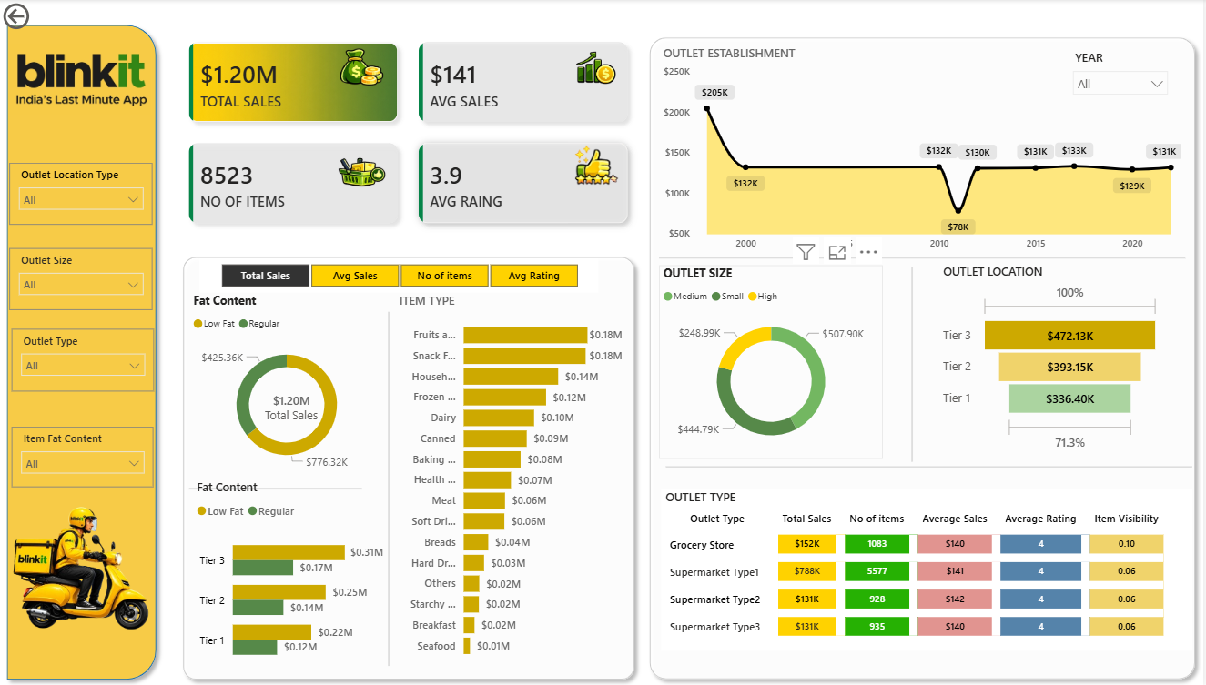
Live Dashboard — Blinkit Sales Analysis

